Slide 1
Hotel Reservation Analysis with SQL
By Ahmed Bilal Umer
Batch – MIP-DA-10

Slide 2
Overview The objective is to analyze hotel reservation data to gain insights into guest preferences, booking trends, and operational factors. It includes various data point which includes meal plans, reservation date, payments which are crucial for making decisions and business plans.

Slide 3
Dataset Booking_ID avg_price_per_room no_of_adults booking_status no_of_children market_segment_type no_of_weekend_nights avg_price_per_room no_of_week_nights lead_time type_of_meal_plan arrival_date

Slide 4
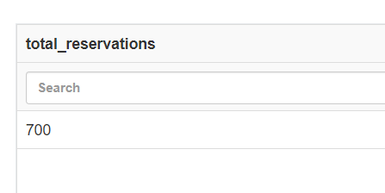
What is the total number of reservations in the dataset?
SELECT COUNT(*) AS total_reservations
FROM hotel_reservation;

Slide 5
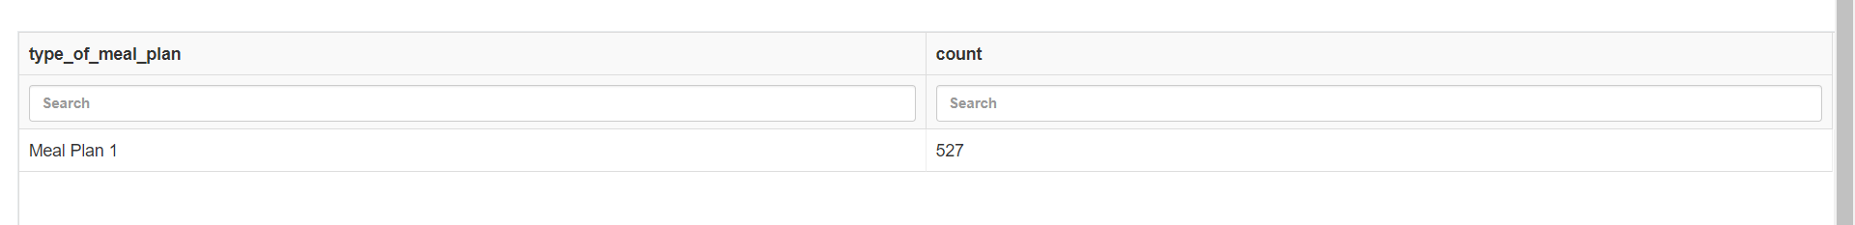
Which meal plan is the most popular among guests?
SELECT type_of_meal_plan, COUNT(*) AS count
FROM hotel_reservation
GROUP BY type_of_meal_plan
ORDER BY count DESC
LIMIT 1;

Slide 6
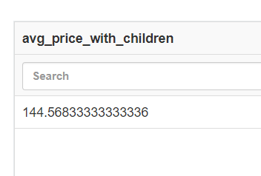
What is the average price per room for reservations involving children?
SELECT AVG(avg_price_per_room) AS avg_price_with_children
FROM hotel_reservation
WHERE no_of_children > 0;

Slide 7
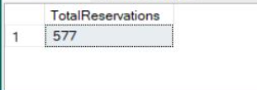
How many reservations were made for the year 20XX (replace XX with the desired year)?
SELECT COUNT(*) AS TotalReservations
FROM hotel_reservation
WHERE YEAR(arrival_date) = 2018;

Slide 8
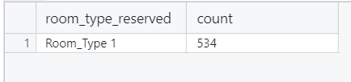
What is the most commonly booked room type?
SELECT room_type_reserved, COUNT(*) AS count
FROM hotel_reservation
GROUP BY room_type_reserved
ORDER BY count DESC
LIMIT 1;

Slide 9
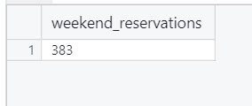
How many reservations fall on a weekend (no_of_weekend_nights > 0)?
SELECT COUNT(*) AS weekend_reservations
FROM hotel_reservation
WHERE no_of_weekend_nights > 0;

Slide 10
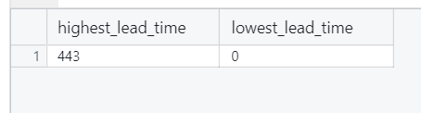
What is the highest and lowest lead time for reservations?
SELECT MAX(lead_time) AS highest_lead_time, MIN(lead_time) AS lowest_lead_time
FROM hotel_reservation;

Slide 11
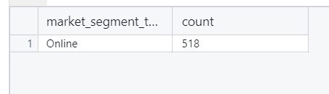
What is the most common market segment type for reservations?
SELECT market_segment_type, COUNT(*) AS count
FROM hotel_reservation
GROUP BY market_segment_type
ORDER BY count DESC
LIMIT 1;

Slide 12
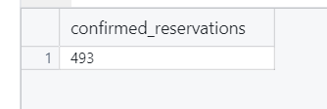
How many reservations have a booking status of "Confirmed"?
SELECT COUNT(*) AS confirmed_reservations
FROM hotel_reservation
WHERE booking_status = 'Not_Canceled';

Slide 13
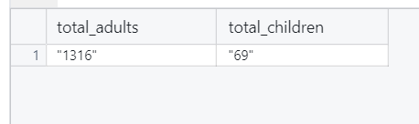
What is the total number of adults and children across all reservations?
SELECT SUM(no_of_adults) AS total_adults, SUM(no_of_children) AS total_children
FROM hotel_reservation;

Slide 14
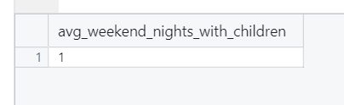
What is the average number of weekend nights for reservations involving children?
SELECT AVG(no_of_weekend_nights) AS avg_weekend_nights_with_children
FROM hotel_reservation
WHERE no_of_children > 0;

Slide 15
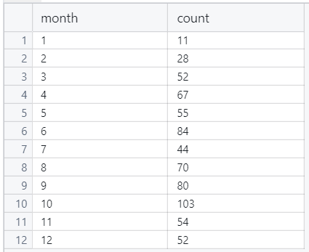
How many reservations were made in each month of the year?
SELECT MONTH(arrival_date) AS month, COUNT(*) AS count
FROM hotel_reservation
GROUP BY MONTH(arrival_date);

Slide 16
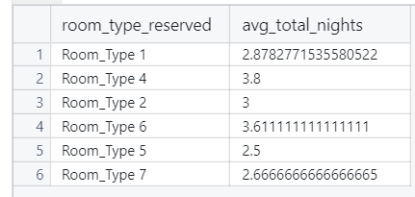
What is the average number of nights (both weekend and weekday) spent by guests for each room type?
SELECT room_type_reserved, AVG(no_of_weekend_nights + no_of_week_nights) AS avg_total_nights
FROM hotel_reservation
GROUP BY room_type_reserved;

Slide 17
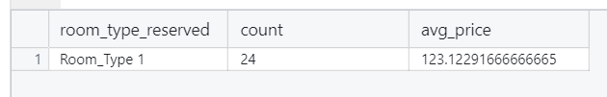
For reservations involving children, what is the most common room type, and what is the average price for that room type?
SELECT room_type_reserved, COUNT(*) AS count, AVG(avg_price_per_room) AS avg_price
FROM hotel_reservation
WHERE no_of_children > 0
GROUP BY room_type_reserved
ORDER BY count DESC
LIMIT 1;

Slide 18
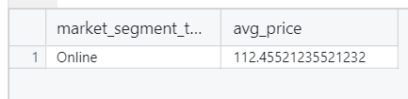
Find the market segment type that generates the highest average price per room.
SELECT market_segment_type, AVG(avg_price_per_room) AS avg_price
FROM hotel_reservation
GROUP BY market_segment_type
ORDER BY avg_price DESC
LIMIT 1;

Slide 19
Conclusion Our analysis of the hotel reservation dataset reveals several key insights. The most popular meal plan is Meal plan 1, and the average price per room for reservations with children is 144.56, suggesting opportunities for tailored family packages. In 2018, there were 577 reservations, aiding trend forecasting. The most booked room type is Room Type 1, informing inventory management. With 383 weekend reservations, weekend promotions are crucial. Lead times range from 443 to 0 days, optimizing booking windows. The dominant market segment is online, targeting marketing efforts. There are 493 confirmed reservations and a total of 1316 adults and 69 children, indicating capacity needs. The most common room type for families is room type 1 with an average price of 123.12. The highest average price per room is generated by the online market segment, focusing premium services and marketing. These insights enable data-driven enhancements in guest experience, operations, and revenue growth.

